Slide 1


Test Approaches on
DRIVER
Image Placeholder
Sheikh Md. Rezone Ullah | 26-September-2023

Slide 2
DRIVER
Project Summary-
Data for Road Incident Visualization, Evaluation, & Reporting (DRIVER) is an open-source web tool introduced by the World Bank. This DRIVER software is an efficient tool designed to streamline the collection, analysis, and reporting of road incident data. This project collaborates with Dhaka Metropolitan Police (DMP) to deploy and configure DRIVER for road safety and incident management in Dhaka.

Slide 3
DRIVER
Test Estimation
The total no of estimated test cases was 132 including both functional and GUI. The estimated effort for test preparation and execution is 10.2 man-days, equivalent to 0.5 man-months. [1]
Estimated time in Man day -
Test Case Design: 4.13
Test Data Preparation: 1.10
Test Case Review: 1.4
Test Execution: 2.20
Bug Retesting: 0.8
Bug Reporting: 0.6

Slide 4
DRIVER
Test Plan in a brief-
Objective: Ensure robust road crash data collection and reporting with the DRIVER web tool.
Scope: Functional testing, UI testing phases.
Test Data: Employ realistic incident data simulation for comprehensive testing.
Reporting: Document and share results, mitigating risks for successful implementation.
[2]

Slide 5
DRIVER
Test case Preparation and area of coverage
A total of 141 test cases [3] were prepared for the application, covering critical functionalities like Login, Dashboard, My Account, Manage Duplicate Record, Add Record, Map, and Record List.
Area of Coverage:
Functional Coverage: Making ensuring the software's many features and functionalities operate as expected by testing them.
User Interface Coverage: Confirming the application's usability and user experience.

Slide 6
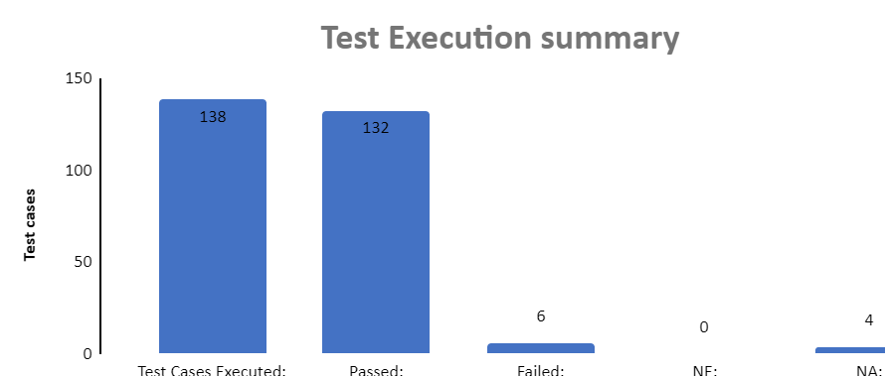
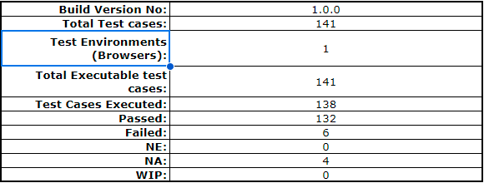
DRIVER
Test Execution and coverage [4]
There are total 141 test cases.
138 all the test cases have been executed

Slide 7

DRIVER
Test Report/Bug Reporting
The DRIVER software version 1.0.0 was tested, and numerous faults were found and reported..[5]

Slide 8
DRIVER
References
1. Test Estimation for Driver Project-Sheikh Md. Rezone Ullah-0030103
2. Test Plan for Driver project-Sheikh Md. Rezone Ullah-0030103
3. Test Case for Driver Project-Sheikh Md. Rezone Ullah-0030103
4. Test Case Execution for Driver Project-Sheikh Md. Rezone Ullah-0030103
5. QA Report For Driver Project-Sheikh Md, Rezone Ullah-0030103
6. Bug Report For Driver Project-Sheikh Md. Rezone Ullah-0030103

Slide 9
Thank you

